Slide 1
Activations and Pooling functions
Group 6

Slide 2
Activation Functions
We were investigating the effect of activation functions on the performance of the model.
We kept all the other parameters and hyperparameters constant and tested the performance of the model using different activation functions in the input and hidden layers.
We kept the output layer activation function as a softmax.
Here some of the results we got

Slide 3
Types of Activation
Relu
Sigmoid
Softmax
Tanh
elu

Slide 4
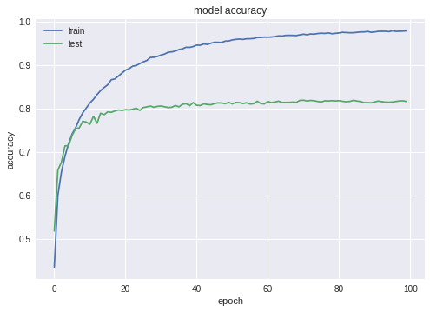
Tanh Activation

Slide 5
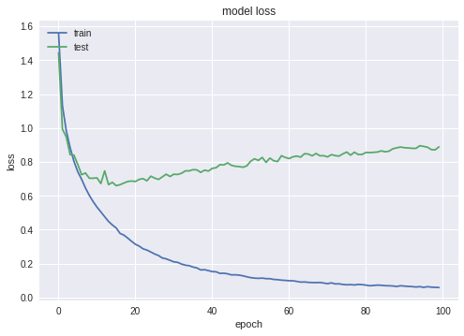
Tanh Activation

Slide 6
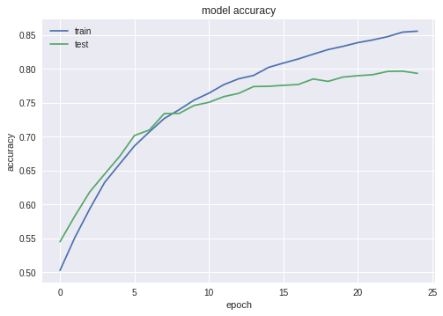
Elu Activation function

Slide 7
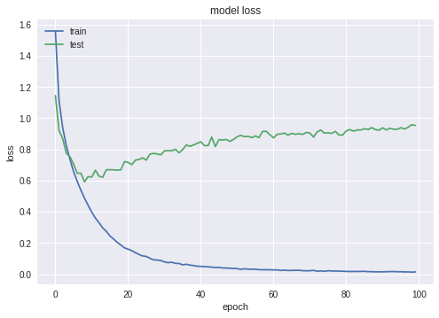

Slide 8
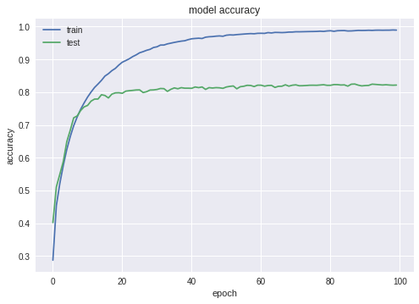
Relu Activation function

Slide 9
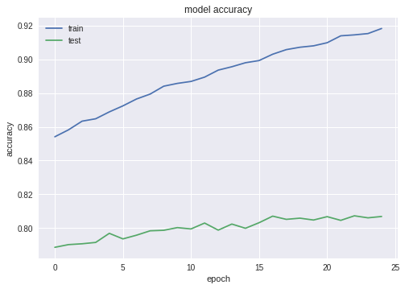
Sigmoid Activation function

Slide 10
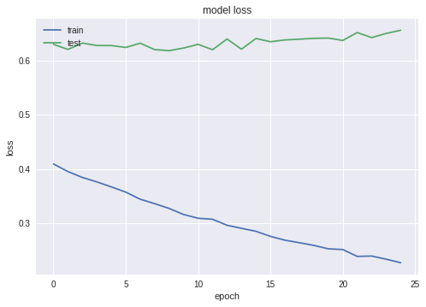
Model loss for Sigmoid

Slide 11
Pooling Layers
MaxPooling2D
MaxPooling1D
MaxPooling3D

Slide 12
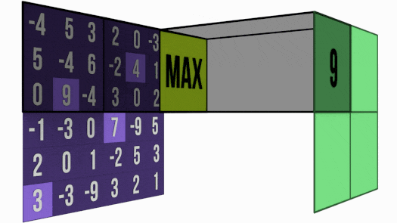
MaxPooling Example

Slide 13
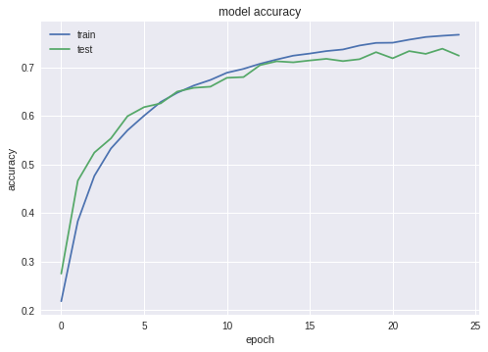
MaxPooling2D (Relu - Hidden Layers)

Slide 14
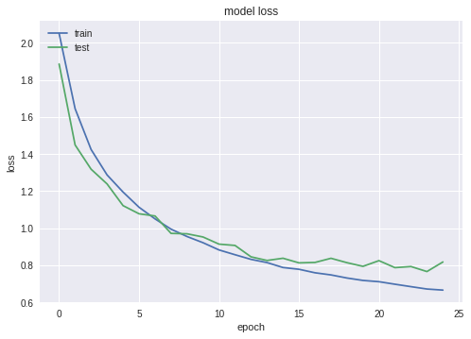
MaxPooling2D (Relu - Hidden Layers)

Slide 15
Pooling Layers
Pooling layers with (3 *3) input to Pooling layers

Slide 16
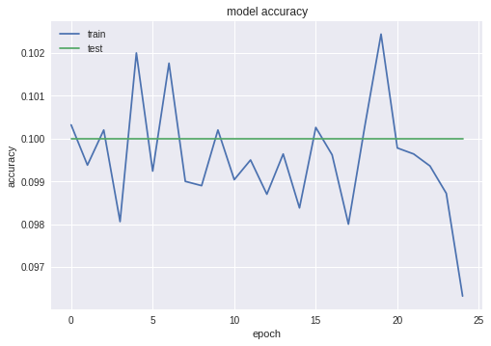

Slide 17
